Slide 1
Chapter 2
Logic Functions and Gates

Slide 2
Basic Logic Functions
Section 2.1

Slide 3
Introduction to Logic
Many digital electronic processes are designed around “logic” circuits.
The Inputs and Outputs in logic have only two values (but many different names):
0 & 1;
HIGH & LOW;
ON & OFF;
TRUE & FALSE.
Logic is ideally suited to help design
digital electronic circuits because of its binary nature.
We will look at some fundamental logic circuits.

Slide 4
Basic Logic Functions
The three basic logic functions are:
AND
OR
NOT

Slide 5
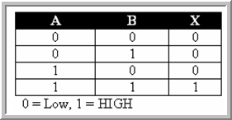
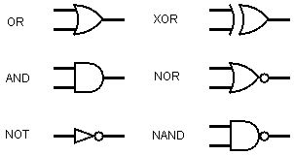
Logic Function Representation
Logic functions can be represented:
Algebraically
using truth tables
using electronic circuits.

Slide 6
Algebraic Representation
Uses Boolean algebra.
Boolean variables have two states (binary).
Boolean operators include AND, OR, and NOT.
Example:

Slide 7
Truth Table Representation
Defines the output of a function for every possible combination of inputs.
A system with n inputs has 2^{n} possible combinations.

Slide 8
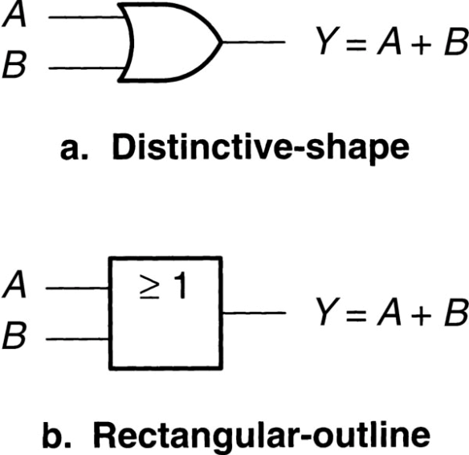
Electronic Circuit Representation
Uses logic gates to perform Boolean algebraic functions.
Gates can be represented by schematic symbols.
Symbols can be either distinctive-shape or rectangular-outline.

Slide 9
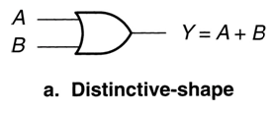
OR Function
Two or more inputs, one output.
Output is HIGH whenever one or more inputs is HIGH.
Output is LOW only when all of the inputs are LOW.

Slide 10
OR Boolean Representation
OR symbol is “+”.

Slide 11
OR Function Truth Table
A | B | Y
0 | 0 | 0
0 | 1 | 1
1 | 0 | 1
1 | 1 | 1

Slide 12

OR Function Electronic Circuit
Called an OR gate.
Distinctive-shape symbol uses OR designation.
Rectangular-shape symbol uses “≥” as designator.

Slide 13
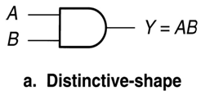
AND Function
Two or more inputs, one output.
Output is HIGH only when all of the inputs are HIGH.
Output is LOW whenever any input is LOW.

Slide 14
AND Boolean Representation
AND symbol is “•” or nothing at all.

Slide 15
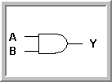
AND Function Truth Table
A | B | Y
0 | 0 | 0
0 | 1 | 0
1 | 0 | 0
1 | 1 | 1
An example of a two input AND Gate's Truth Table
Note that the AND function is similar to multiplication in linear algebra: "Y equals A AND B"

Slide 16
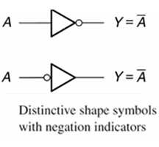
NOT Function (invert)
One input and one output.
The output is the opposite logic level of the input.
The output is the complement of the input.
Example:
A=0
A=1

Slide 17
NOT Function Boolean Representation
Inversion is indicated by a bar over the signal to be inverted.

Slide 18
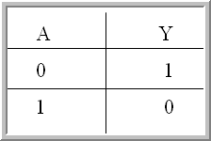
NOT Function Truth Table
A truth table is a list of all possible input values and the output resulting from each one.
The above truth table is for the inverter, where A is the input variable and Y is the output

Slide 19
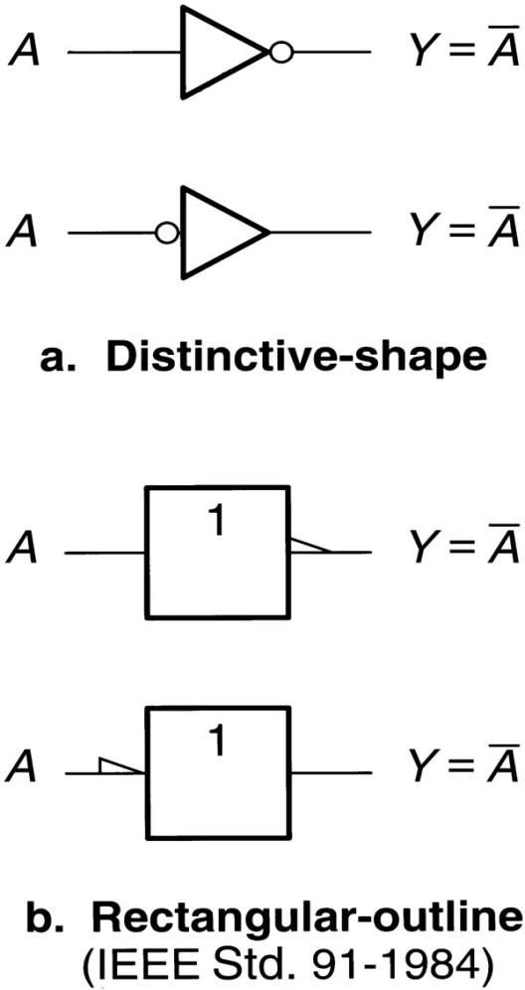
NOT Function Electronic Circuit
Called a NOT gate or, more usually, an INVERTER.
Distinctive-shape symbol is a triangle with inversion bubble.
Rectangular-shape symbol uses “1” and the inversion 1/2 arrowhead.

Slide 20

Distinctive Shape Schematic Symbols
Uses different graphic representations for different logic functions.
Uses a bubble (a small circle) to indicate a logical inversion.

Slide 21

AND Function Truth Table (three input)
A | B | C | Y
0 | 0 | 0 | 0
0 | 0 | 1 | 0
0 | 1 | 0 | 0
0 | 1 | 1 | 0
1 | 0 | 0 | 0
1 | 0 | 1 | 0
1 | 1 | 0 | 0
1 | 1 | 1 | 1
An example of a three input AND Gate's Truth Table

Slide 22
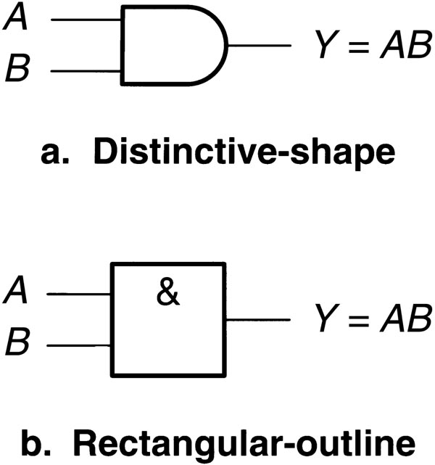
AND Function Electronic Circuit
Called an AND gate.
Distinctive-shape symbol uses AND designation.
Rectangular-shape symbol use “&” as designator.

Slide 23



One Last Note…
Boolean expressions for AND gates with two, three, and four inputs.
Note that the output here is labelled X versus Y, which is another industry-standard labelling convention.

Slide 24
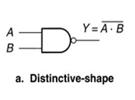
NAND Function
Generated by inverting the output of the AND function.
Output is HIGH whenever any input is LOW.
Output is LOW only when all inputs are HIGH.

Slide 25
NAND Boolean Representation
Uses AND with an inversion overbar.

Slide 26
NAND Function Truth Table
A | B | Y
0 | 0 | 1
0 | 1 | 1
1 | 0 | 1
1 | 1 | 0

Slide 27

NAND Function Electronic Circuit

Slide 28
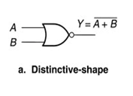
NOR Function
Generated by inverting the output of the OR function.
Output is HIGH only when all inputs are LOW.
Output is LOW whenever any input is HIGH.

Slide 29
NOR Boolean Representation
Uses OR with an inversion overbar.

Slide 30
NOR Function Truth Table
A | B | Y
0 | 0 | 1
0 | 1 | 0
1 | 0 | 0
1 | 1 | 0

Slide 31

NOR Function Electronic Circuit

Slide 32

Active Level
The logic level defined as “ON” for a circuit.
When a logic LOW is “ON”, the signal is active-LOW.
When a logic HIGH is “ON”, the signal is active-HIGH.
Example
More Examples Later…

Slide 33
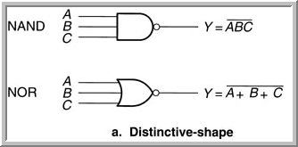
3 Input NOR and NAND Function – Boolean Expressions
3 Input NAND:
3 Input NOR:

Slide 34

3 Input NOR and NAND Function – Truth Tables
A | B | C
0 | 0 | 0 | 1 | 1
0 | 0 | 1 | 1 | 0
0 | 1 | 0 | 1 | 0
0 | 1 | 1 | 1 | 0
1 | 0 | 0 | 1 | 0
1 | 0 | 1 | 1 | 0
1 | 1 | 0 | 1 | 0
1 | 1 | 1 | 0 | 0

Slide 35
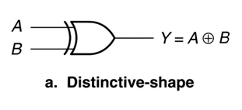
Exclusive OR (XOR) Gate – page 41
Two inputs, one output.
Output is HIGH when one, and only one, input is HIGH.
Output is LOW when both inputs are equal – both HIGH or both LOW.

Slide 36

XOR Boolean Representation
Exclusive OR ( XOR ) symbol is " " .

Slide 37
XOR Gate – Truth Table
A | B | Y
0 | 0 | 0
0 | 1 | 1
1 | 0 | 1
1 | 1 | 0

Slide 38
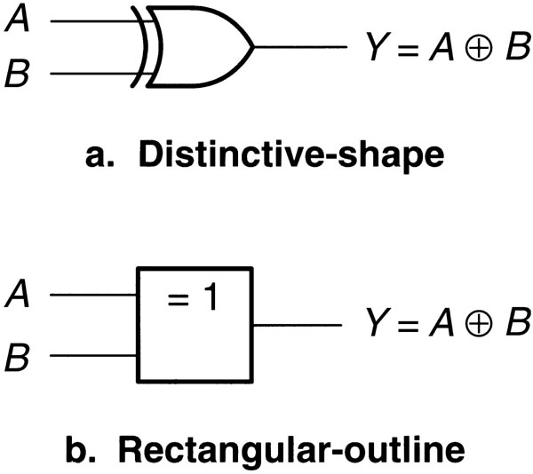
XOR Gate Electronic Circuit

Slide 39
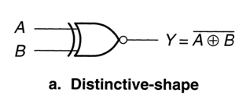
Exclusive NOR (XNOR) Gate – page 41
Two inputs, one output.
Output is HIGH when both inputs are equal – both HIGH or both LOW.
Output is LOW when one, and only one, input is HIGH.

Slide 40
XNOR Boolean Representation
Exclusive OR ( XOR ) symbol is " " .
Exclusive NOR (XNOR) is the complement of the XOR

Slide 41
XNOR Gate – Truth Table
A | B | Y
0 | 0 | 1
0 | 1 | 0
1 | 0 | 0
1 | 1 | 1

Slide 42
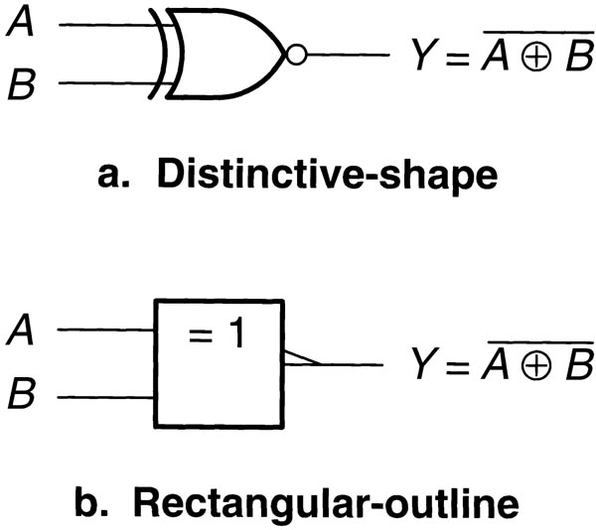
XNOR Gate Electronic Circuit

